Slide 1
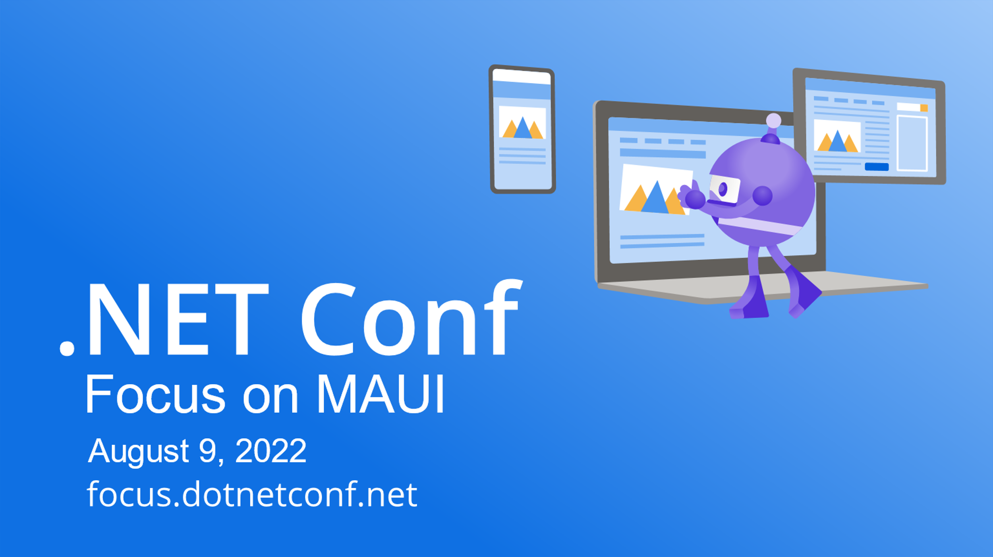

Slide 2


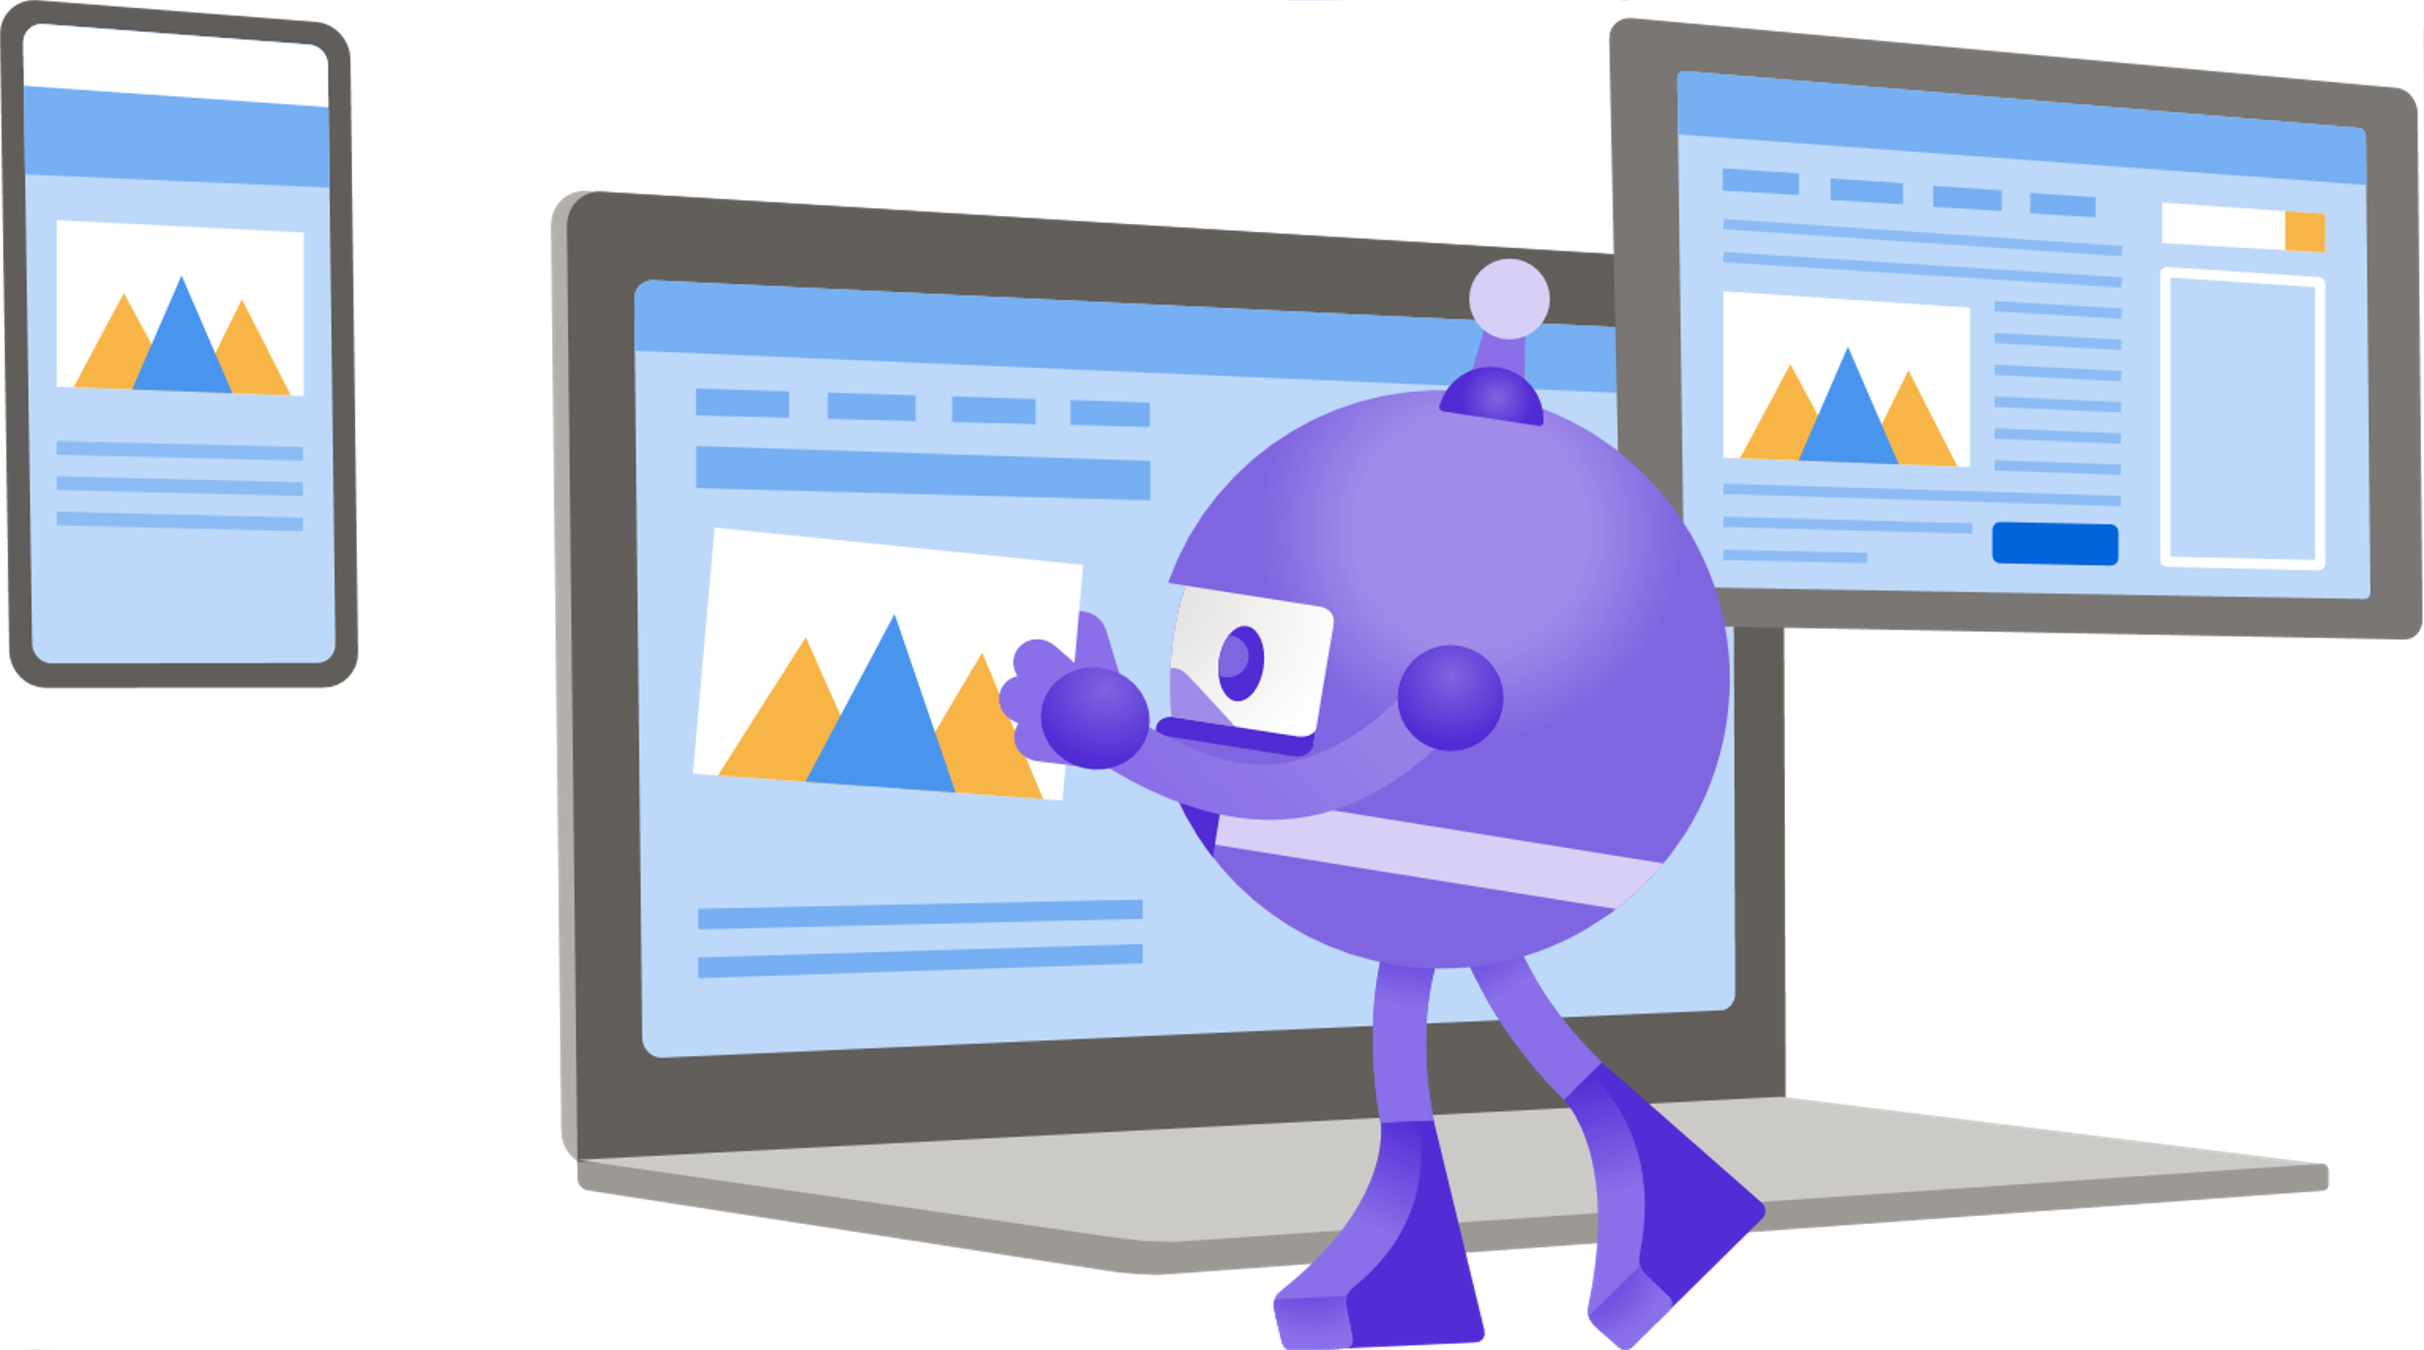
Zero to Mobile Database Hero
Luce Carter | She/Her | @LuceCarter1 | Developer Advocate - MongoDB

Slide 3
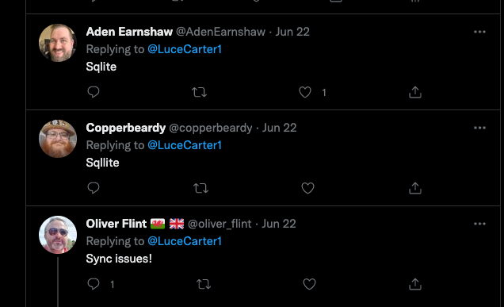
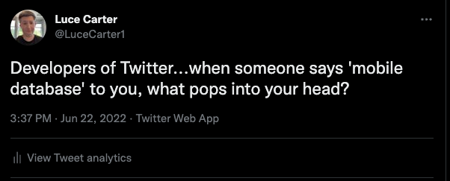
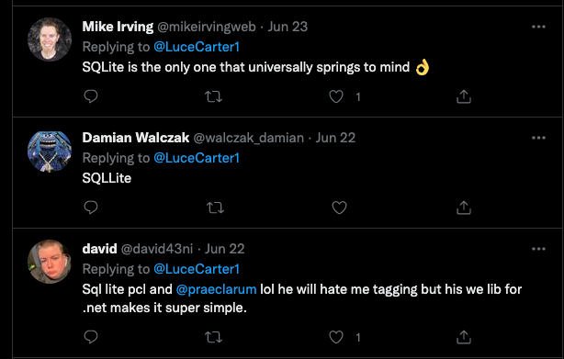
Story time..
@LuceCarter1

Slide 4





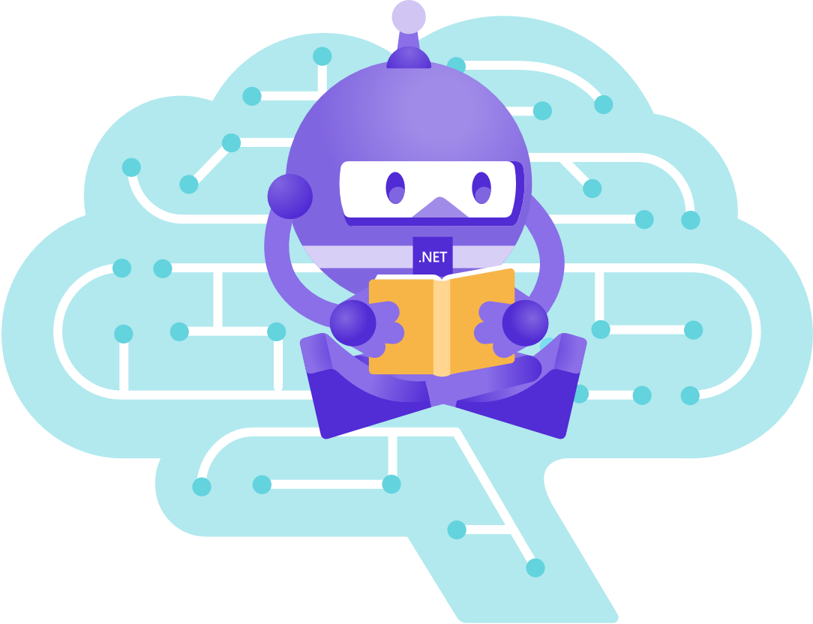
SELECT * FROM DatabaseHistory WHERE user = 'Luce';
2009
2010
2015
2017
2021
College
University
Fujitsu
BBC
MongoDB
First started learning Microsoft SQL
Taught Oracle SQL
First learned about PostgreSQL and SQLite.NET
Used Amazon RDS
Document Databases ftw!
@LuceCarter1

Slide 5
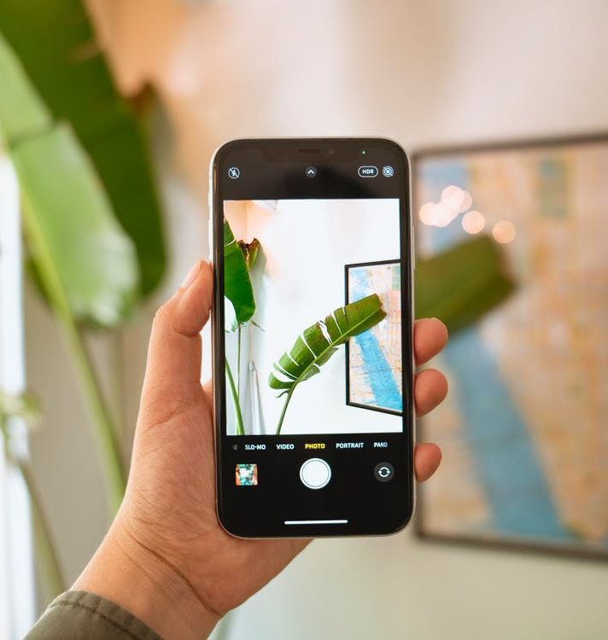
Mobile experiences are expected, but difficult to deliver
Today, people expect to use their mobile devices for everything – shopping, finances, and even work. A record-breaking number of new apps debuted in 2021, many of them business apps tackling digital transformation initiatives.
70% of these digital transformation initiatives fail…
— BCG (2020)
@LuceCarter1

Slide 6



Fast, reactive UI
The app’s UI must update immediately to changes without lag, and the app should be stable and secure without crashes.
Successful apps meet modern user expectations
Reliable, real-time data
The data and user experience must continuously stay up-to-date across multiple concurrently active users and devices.
Adoption by consumers or employees is critical to an app’s success
Always-on experience
The app must function and be reliable even with intermittent connectivity.
@LuceCarter1

Slide 7
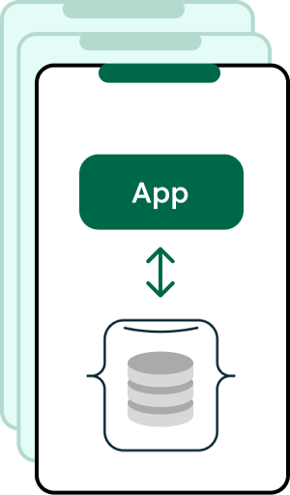

Architect a mobile app
Mobile devices with
local data
Required for offline functionality, app performance, and responsiveness
Data synchronization
Required to reflect changing data from multiple users/devices to deliver a consistent and reliable experience
Backend database
@LuceCarter1

Slide 8
Sync solutions are complex, and rarely unique
Mobile devices with local data
ORM
NATIVE OBJECT
JSON
PUSH NOTIFICATION
Data synchronization
PUSH SERVICE
REST CALL
TO API
Backend database
BACKEND OBJECT
MSG QUEUE
@LuceCarter1

Slide 9
Device and network limitations add complexity
Mobile devices with local data
ORM
NATIVE OBJECT
JSON
COMPLEX RETRY &
ERROR HANDLING
PUSH NOTIFICATION
Data synchronization
OFFLINE?
PUSH SERVICE
REST CALL
TO API
POTENTIAL APP CRASH
Backend database
INVALID DATA?
SERVER ERROR?
TIMED OUT?
BACKEND OBJECT
MSG QUEUE
@LuceCarter1

Slide 10
Real-time experiences at scale require
complex conflict resolution
Mobile devices with local data
ORM
NATIVE OBJECT
JSON
WRITE CONFLICTS?
WRITE CONFLICTS?
COMPLEX RETRY &
ERROR HANDLING
PUSH NOTIFICATION
Data synchronization
OFFLINE?
PUSH SERVICE
REST CALL
TO API
POTENTIAL APP CRASH
Backend database
INVALID DATA?
SERVER ERROR?
TIMED OUT?
BACKEND OBJECT
MSG QUEUE
@LuceCarter1

Slide 11

Reinventing the wheel is risky
Goals are missed
Resources are wasted
Data is siloed
A subpar user experience pushes users to alternative solutions, thwarting business goals.
Teams spend time reinventing the wheel – and maintaining this code – instead of innovating proprietary technology.
Without real-time data connectivity, teams are left in the dark and business insights are inaccurate.
@LuceCarter1

Slide 12
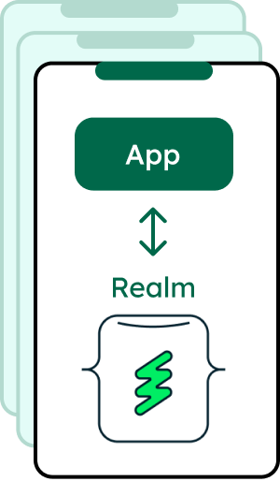


MongoDB is the easiest way to build & scale mobile apps
Realm
Mobile-optimized data store
Atlas Device Sync
Out-of-the-box device-cloud synchronization
Lightning fast
Super lightweight
No ORM needed
No DAO needed
Dynamic, flexible sync options
Granular permissions
Built-in conflict resolution
Built-in error handling
Atlas
The leading
Developer Data Platform
on the cloud
@LuceCarter1

Slide 13


Realm & Atlas Device Sync makes it easier
Simplified data structure
Mobile Phone
Object-oriented database eliminates the need for data mapping and an ORM.
App
Automatic network handling
Sync handles network loss and recovery for you.
Atlas Device Sync
MongoDB Atlas
Fully-managed
Syncs serverless architecture lets devs focus on innovating, not managing.
@LuceCarter1

Slide 14
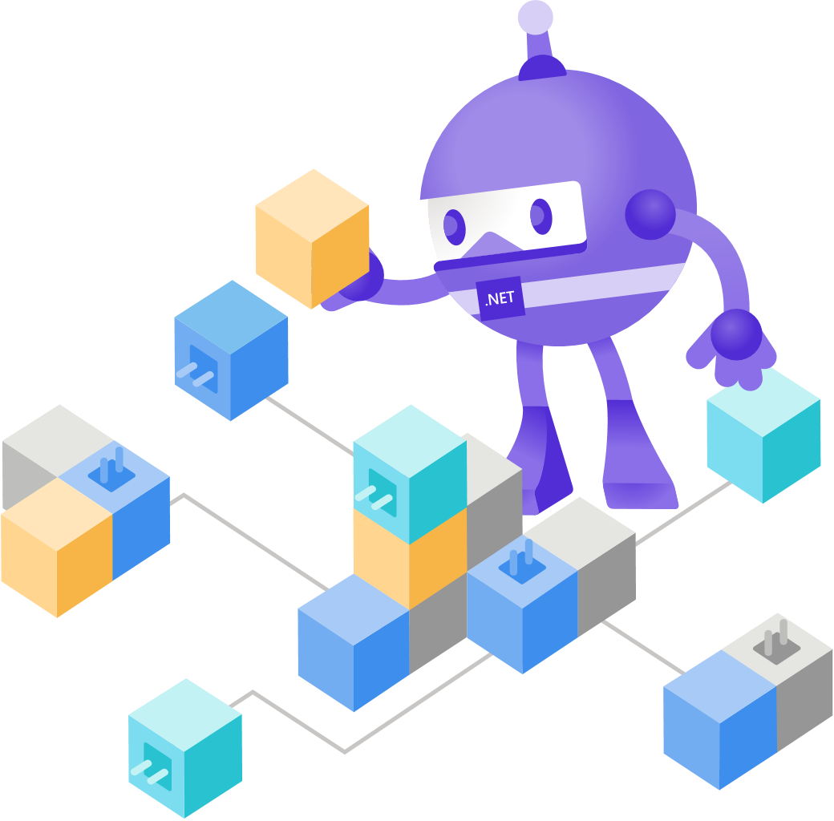
But there’s more…
@LuceCarter1

Slide 15



Atlas App Services
Functions
Define and execute JavaScript functions to build APIs, integrate with cloud services, and more.
Triggers
Automatically run code in response to database changes, user events, or at preset intervals.
Authentication
Configure one or more authentication providers for your application including Oauth 2.0, AppleID, Google and Facebook.
@LuceCarter1

Slide 16

Realm already supports MAUI!!
@LuceCarter1

Slide 17
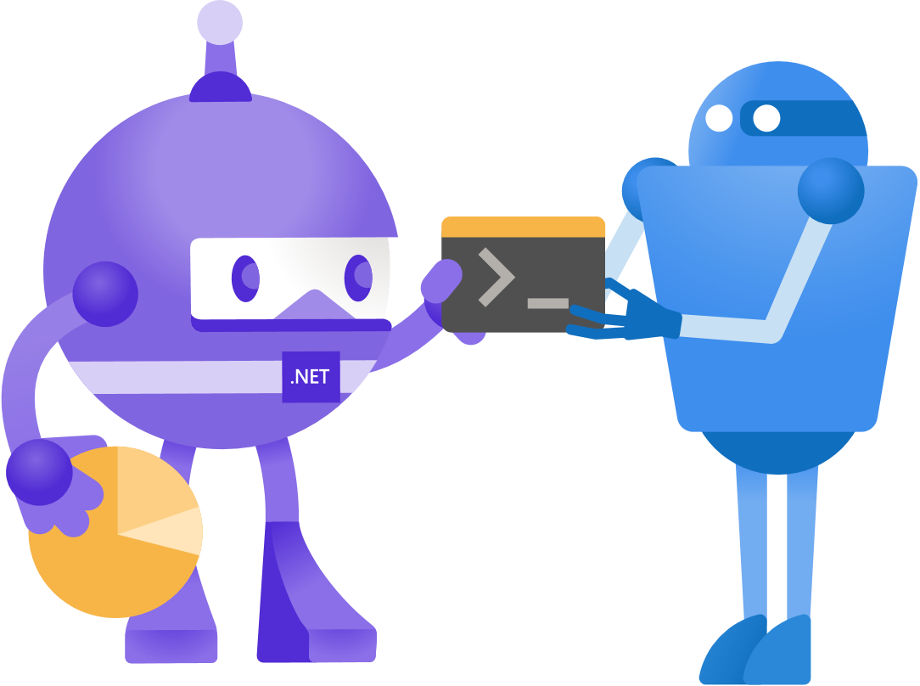
Demo Time!
@LuceCarter1

Slide 18
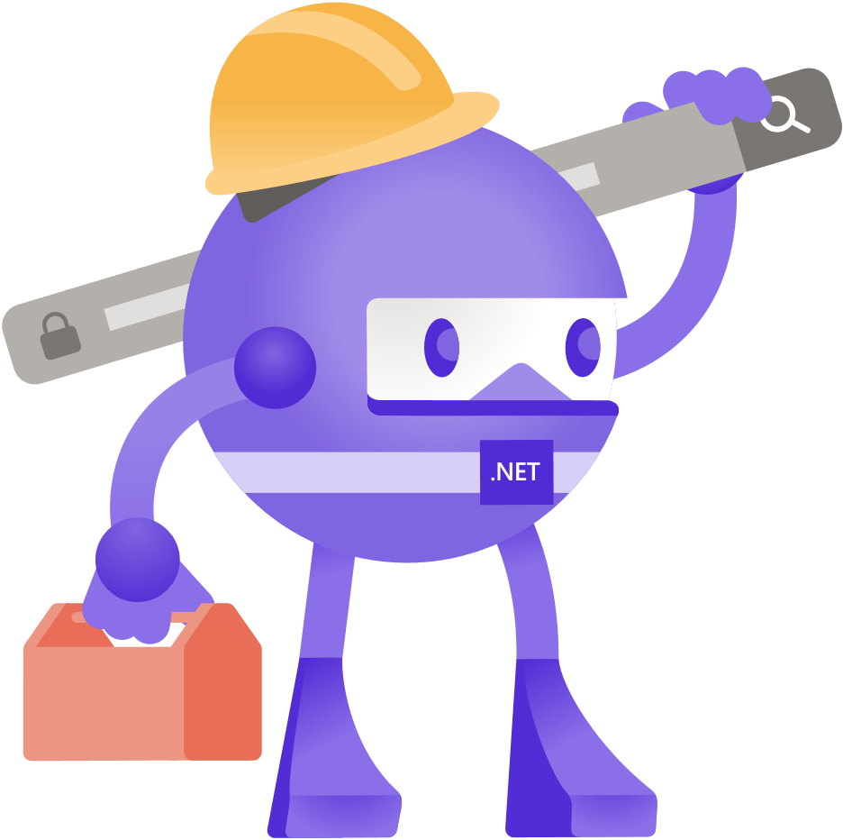
How this was made
@LuceCarter1

Slide 19
Future Plans
Migrate an existing Realm and Xamarin.Forms app into MAUI – BloodPressureTracker
Migrate an old Xamarin.Forms + Cognitive Services App - EmotiPal
@LuceCarter1

Slide 20
Summary
Mobile apps more than ever need to meet user expectations to succeed
Realm and MongoDB’s Developer Data Platform makes this easier
Realm supports MAUI so we can surf our way to data storage victory
@LuceCarter1

Slide 21
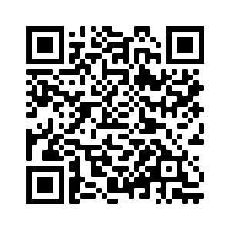
Learn More
https://bit.ly/ZeroToMobileDBHero
@LuceCarter1

Slide 22
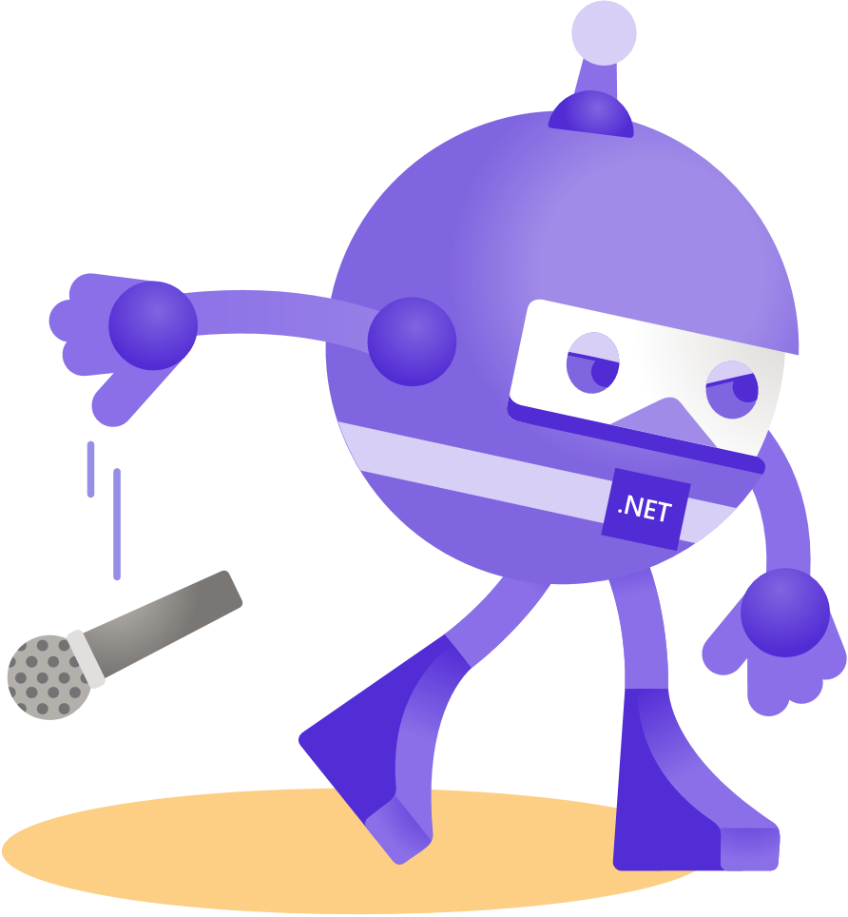
Thanks for joining!
Ask your questions live on Twitter #dotNETConf
@LuceCarter1

